Slide 1
Implementing High Availability Strategies
Ensuring uptime and reliability in IT systems

Slide 2
Introduction to High Availability
- HA ensures minimal downtime and continuous operation
- Uses redundancy, failover mechanisms, and monitoring
- Essential for mission-critical applications

Slide 3
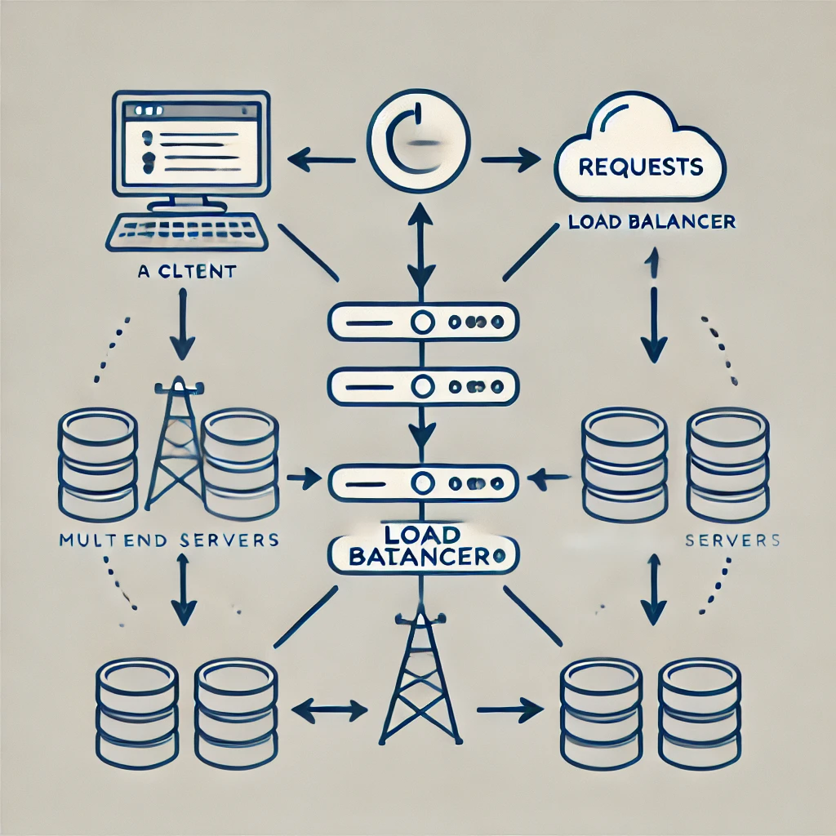
Load Balancing
- Distributes incoming traffic across multiple servers - Prevents overloading a single server - Improves system performance and reliability

Slide 4

Failover Clustering
- Automatic switch to backup systems if primary fails - Used in database servers, web applications, and cloud services - Ensures continuous service availability

Slide 5
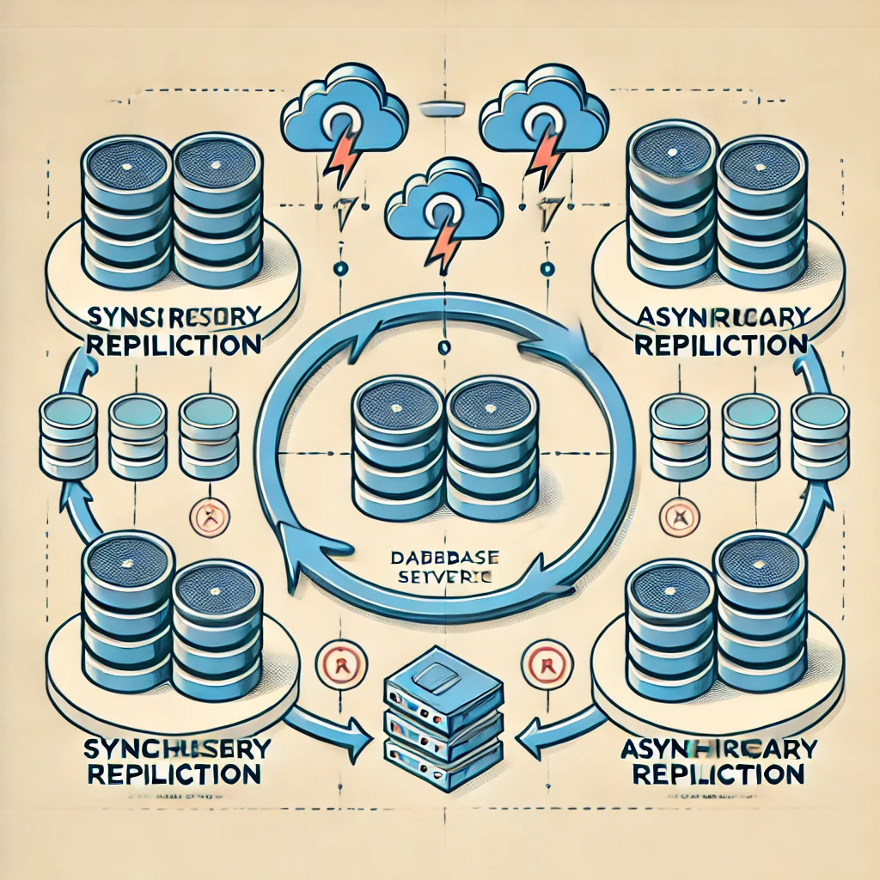
Data Replication Strategies
- Synchronous vs. Asynchronous replication - Ensures data consistency across multiple locations - Common in disaster recovery planning

Slide 6
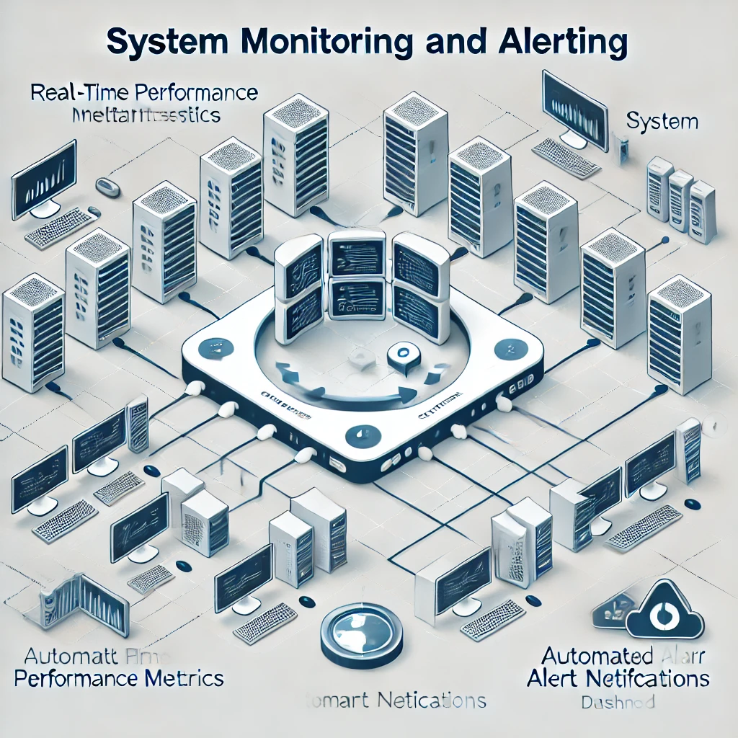
Monitoring and Alerting Systems
- Real-time system health monitoring - Automated alerts for failures - Helps in proactive issue resolution

Slide 7
Conclusion
- High availability is crucial for modern IT systems
- Implementing HA reduces downtime and ensures business continuity
- Requires redundancy, failover mechanisms, and proactive monitoring

